Slide 1
Brave New World
Life in the NHS after the Health and Care Bill

Slide 2
What we will cover…
Key points from the Health and Care Bill
Integrated Care Systems, Boards & Partnerships
Purchaser-provider split… replaced by Provider Collaboratives
‘Activity x tariff’ contracts… replaced by Aligned Incentive Contracts
National Tariff… replaced by NHS Payment Scheme
New approach for Specialised Commissioning

Slide 3
Firstly, a ‘quick’ jargon buster!
Term | Meaning
Integrated Care System | The collective term for the NHS organisations that cover a specified geographical area, large enough to plan strategically, with input from non-NHS partners
Integrated Care Board | The proposed governing body of an ICS, as set out in the Bill
Integrated Care Partnership | A proposed joint planning committee of NHS, local govt and other interested parties covering an ICS, as set out in the Bill
Place | A ‘natural locality’ within an ICS covering 250-500k people, typically coterminous with a local authority and/or former CCG
Provider Collaborative | A number of providers working jointly across multiple Places to achieve specified objectives, from loose alliance working to a formal contractual joint venture
Place-Based Partnership | Similar to a Provider Collaborative, but where providers work in a single Place
Integrated Care Provider | Previous term used in The NHS Long-Term Plan for provider collaborative working, usually specifically referring to integrating primary and secondary care, sometimes also social care

Slide 4
Sorry, more jargon…
Term | Meaning
Alliance Contracting | Where a commissioner holds a contract involving multiple providers
Provider Alliance | The collective term for the providers that are party to an alliance contract
Prime contractor | The lead party within a provider alliance, who holds the head contract with the commissioner. In practice, used interchangeably with prime provider.
Prime provider | A type of prime contractor, where the contractor also provides some of the contracted services. In practice, used interchangeably with prime contractor.
Aligned Incentive Contract (AIC) | General term for a contract where the payment mechanism is based on a fixed block payment, plus a smaller gain/risk share element depending on performance in year
Aligned Payment & Incentive Approach | Specific national rules for implementing AICs, as set out in the 2021/22 National Tariff Payment System guidance (effective from 1/10/21)
Patient Outcomes | A quantifiable measure of the health benefit delivered to patients, e.g. reduction in under-75 mortality rate from cardiovascular disease

Slide 5
Latest guidance can be found here…
Integrated Care Systems
https://www.england.nhs.uk/publication/integrated-care-systems-guidance/
National Tariff/
Payment Reform
(2022/23 not yet published, out to re-consultation until 25 March)
https://www.england.nhs.uk/pay-syst/national-tariff/
NHS Standard
Contract
(2022/23 contract published
2 March)
https://www.england.nhs.uk/nhs-standard-contract/

Slide 6
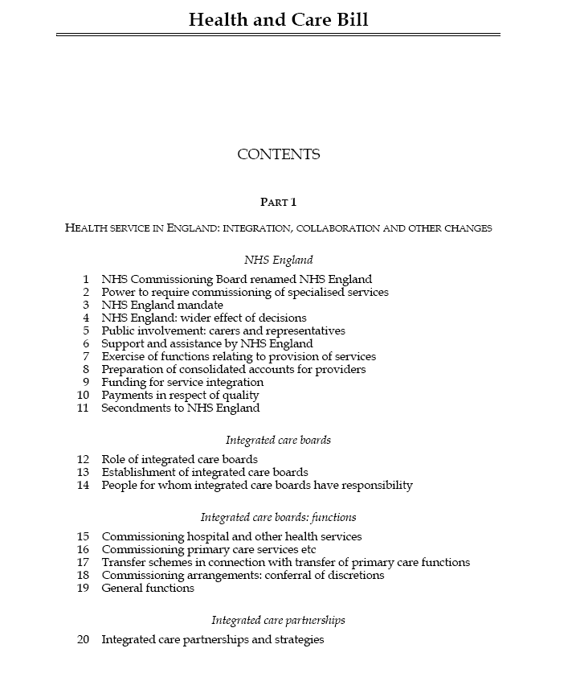
Health and Care Bill

Slide 7
Health and Care Bill: key points
Formalises what’s happened anyway… integrated systems, bigger role for local govt, single regulator
Local flexibility encouraged… will that last?
More controversial?
Broadly welcomed…
New powers for Sec of State to intervene in reconfigurations and to direct NHSE
Govt proposals on social care reform very limited in scope – mainly funding mechanism, only £1.8bn pa new investment thus far
No big strategy to address workforce shortages and current staff exhaustion
Overlapping roles of NHSE v ICB v ICP v Places v Neighbourhoods?
‘Triple aim’ of better population health, quality of care and sustainable use of resources
Payment reform… national tariff replaced with NHS Payment Scheme and locally agreed pricing
Removes quasi-market competition and procurement rules
Nothing yet on future role of public health

Slide 8
Progress to date – ICS from 1 July 2022?
23 November
Cleared House of Commons after third reading (majority 50 votes)
24 November
Entered House of Lords (first reading)
7 December
House of Lords second reading
11 January 2022
House of Lords committee stage
23 March
House of Lords passed amended Bill back to Commons after third reading
May 2022?
Royal Assent
30 March
House of Commons start considering Lords’ amendments (‘ping pong’ stage)
6 July 2021
Entered House of Commons (first reading)
31 March
Commons rises for Easter recess
19 April
Commons returns from Easter recess

Slide 9
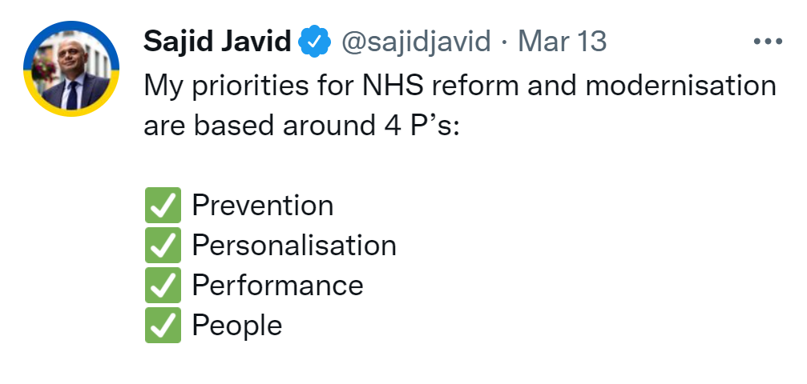
March 2022: Secretary of State’s 4 P’s:
Prevention
Personalisation
Performance
People
COVID backlog
Community Diagnostic Centres
Cardiovascular disease
Vaccination
Personalised budgets
Right to Choose
Patient voice
Digital first
Big data & AI
Partnerships for reform
Long-term workforce plan
Leadership review

Slide 10
Integrated Care Systems, Boards & Partnerships

Slide 11
Integrated Care Systems
NHS England
Care Quality Commission
NHS England regions
Integrated Care Systems
ICB
ICP
provider collaboratives
place-based partnerships
primary care networks

Slide 12
Integrated Care Boards & Partnerships
Integrated Care Board
Must have a Chair and at least 2 non-executive directors
plus at least 1 member nominated by each of providers, primary care & local govt
Integrated Care Partnership
One member appointed by ICB and by each local authority
Other members appointed by ICP locally
Charged with preparing ‘integrated care strategy’ for ICS
Chair and Chief Executive appointed by NHS England
Statutory body under the Bill
Statutory joint committee between NHS and Local Govt under the Bill
plus Chief Executive, Chief Finance Officer, Chief Nursing Officer and Chief Medical Officer
https://www.england.nhs.uk/wp-content/uploads/2021/06/B0886_Interim-guidance-on-the-functions-and-governance-of-the-integrated-care-board-August-2021.pdf

Slide 13
Integrated Care Boards & Partnerships
Integrated Care Board
Integrated Care Partnership
Chair
Chief Exec
3 x Execs
2 x NEDs
Chair
?
?
PC rep
Provider rep
LA rep
ICB rep
Reps from each LA
?
Primary Care
Local Authorities
Providers
https://www.england.nhs.uk/wp-content/uploads/2021/06/B0886_Interim-guidance-on-the-functions-and-governance-of-the-integrated-care-board-August-2021.pdf

Slide 14
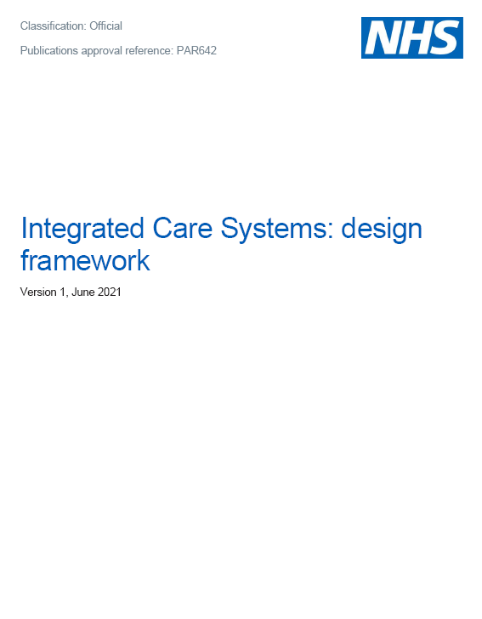
Provider Collaboratives

Slide 15
Provider Collaboratives
Acute and MH providers asked to work collaboratively at greater scale
Could be any combination of:
Loose alliance with joint committee(s), possibly joint Board members
Contractual model – lead provider with subcontracted providers
Joint venture model – JV agreement between provider members
Trust mergers/takeovers
Expected that ultimately collaboratives will have ICB’s commissioning functions delegated to them and ICB only deals with ‘strategic’ commissioning

Slide 16
Provider collaborative example: loose alliance
Also known as:
Alliance contracting
Integrated care partnerships
Integrated care providers
Integrated Care Board
manages ICS overall
Provider Collaborative
loose alliance with joint committee(s) and possibly sharing Board members
Other providers outside collaborative
(unplanned activity, planned extra capacity etc)
Integrated Care Board
Provider 1
Non-contracted provider
Provider 2
Provider 3
Non-contracted provider
https://www.england.nhs.uk/wp-content/uploads/2021/06/B0754-working-together-at-scale-guidance-on-provider-collaboratives.pdf

Slide 17
Provider collaborative example: lead provider model
Integrated Care Board
manages ICS overall
Provider Collaborative
Led by one member, who subcontracts to other members
Other providers outside collaborative
(unplanned activity, planned extra capacity etc)
Integrated Care Board
Lead Provider
Non-contracted provider
Non-contracted provider
Sub-contracted provider
Sub-contracted provider
Sub-contracted provider
https://www.england.nhs.uk/wp-content/uploads/2021/06/B0754-working-together-at-scale-guidance-on-provider-collaboratives.pdf

Slide 18
Provider collaborative example: joint venture model
Integrated Care Board
manages ICS overall
Provider Collaborative
Joint Venture governed by a JV agreement and with a distinct identity… tends to end up with joint committees/Boards, then Trust merger!
Other providers outside collaborative
(unplanned activity, planned extra capacity etc)
Provider 1
Integrated Care Board
Non-contracted provider
Provider 2
Non-contracted provider
Provider 3
https://www.england.nhs.uk/wp-content/uploads/2021/06/B0754-working-together-at-scale-guidance-on-provider-collaboratives.pdf

Slide 19
‘Place-Based Partnerships’
Integrated Care Board
manages ICS overall
Place-Based Partnership
Integrated Care Board
Partnership Board with pooled budget
Local Authority
Provider 1 e.g. community provider
Provider 2 e.g. GP federation
Provider 3 e.g. social care provider
https://www.england.nhs.uk/wp-content/uploads/2021/06/B0660-ics-implementation-guidance-on-thriving-places.pdf

Slide 20
Some possible types of collaboration
Footprint | Scope | Focus | Potential Objectives
Cross-system collaborative | All organisations providing NHS and social care | Defined population that crosses ICS boundaries, e.g. adolescent eating disorders | Economies of scale Consistent service offer Integrate health & social care
System-wide ‘horizontal’ collaborative | All acute NHS providers in our ICS | Best possible service provision within our ICS’s limited resources | Rationalise acute services and staff across sites Strategic forward planning
System-wide ‘vertical’ collaborative | Acute, mental health and social care providers in our ICS | Frail older people in our ICS with >2 LTCs | Integrate hospital & out-of-hospital care Reduce emerg admissions to hospital
Place-based partnership | Community, primary, social and voluntary care services | Defined locality population, e.g. older people in our PCN | Integrated health, well-being & prevention service
Neighbourhood partnership | Primary Care Network | Defined neighbourhood with specific health needs | Integrated primary care service (GPs, nurses, dentists, pharmacy, opticians, etc)
largest
smallest

Slide 21
Aligned Incentive Contracts

Slide 22
Navigating the new world
As we move away from activity x price and towards risk sharing contracts… what will we measure and how will we pay for it?
1. Understanding and documenting service pathways
2. Commissioning for patient outcomes
3. Costing and benchmarking
Shared understanding of the services required
Simple charts & maps
Getting the right people in the room
Distinguishing outcomes from inputs and outputs
Why commission for outcomes?
Measuring outcomes using KPIs
How does provider costing work?
Benchmarking efficient costs
Why look at provider costs?
National guidance

Slide 23
Understanding and documenting ICS service pathways
WHO?
Who is the service for?
WHY?
Why deliver in this way?
HOW?
Where will the service be delivered?
WHERE?
WHAT?
What is the patient cohort?
What is the national or local evidence?
How do patients get referred in?
How do they get discharged?
What is the best clinical practice?
What are the pathway stages?
A good way to start working more collaboratively is to develop a shared understanding of the main service pathways provided to the ICS population
You could use the NHS Standard Contract service spec template or your own formats

Slide 24
Commissioning for outcomes
The NHS Outcomes Framework sets out high-level national key outcomes:
https://digital.nhs.uk/data-and-information/publications/statistical/nhs-outcomes-framework
Domain 1 | Preventing people from dying prematurely
Domain 2 | Enhancing quality of life for people with long-term conditions
Domain 3 | Helping people to recover from episodes of ill health or following injury
Domain 4 | Ensuring that people have a positive experience of care
Domain 5 | Treating and caring for people in a safe environment & protecting them from avoidable harm

Slide 25
Aligned incentive contracts
Aim is to incentivise different parts of local health systems to work together to deliver patient benefit (using measurable outcomes)
Unlikely that any single provider of care can deliver patient outcomes in isolation from other providers
Understand how resources used across the whole patient pathway, rather than individual provider contracts
So let’s design contracts and payment terms that encourage this, rather than each provider trying to maximise its volume of activity under a traditional ‘PbR’ volume x price contract

Slide 26
What might this look like in practice?
Payments based on block element to provide financial stability and cover for fixed costs, so change is not immediately gridlocked
Plus incentive element for contributing towards patient outcomes and/or risk/gain sharing agreement on volume/cost pressures
No blame/no fines for ‘failure’ – system uses data to work out how to improve its performance
Contract levers only used as a backstop – seen as a sign of system failure that needs to be addressed at source

Slide 27
NHS Standard Contract 2022/23
NHSE have gone for minimal change, given everything else that is going on
The usual raft of minor tweaks to reflect latest govt policies
National scheme to novate signed contracts from CCGs to ICBs on 1 July
No longer need to exchange GCs/SCs as will be published online nationally
National op/quality standards (sch 4A/4B) moved to SCs, no more fines for “failure”
No more SCFMA (sch 9), as duty to collaborate will be required by law (?)
Challenge is to use the docs to introduce changes envisaged by the Bill… but arguably not really suited to new world of ICS and provider collaboratives

Slide 28
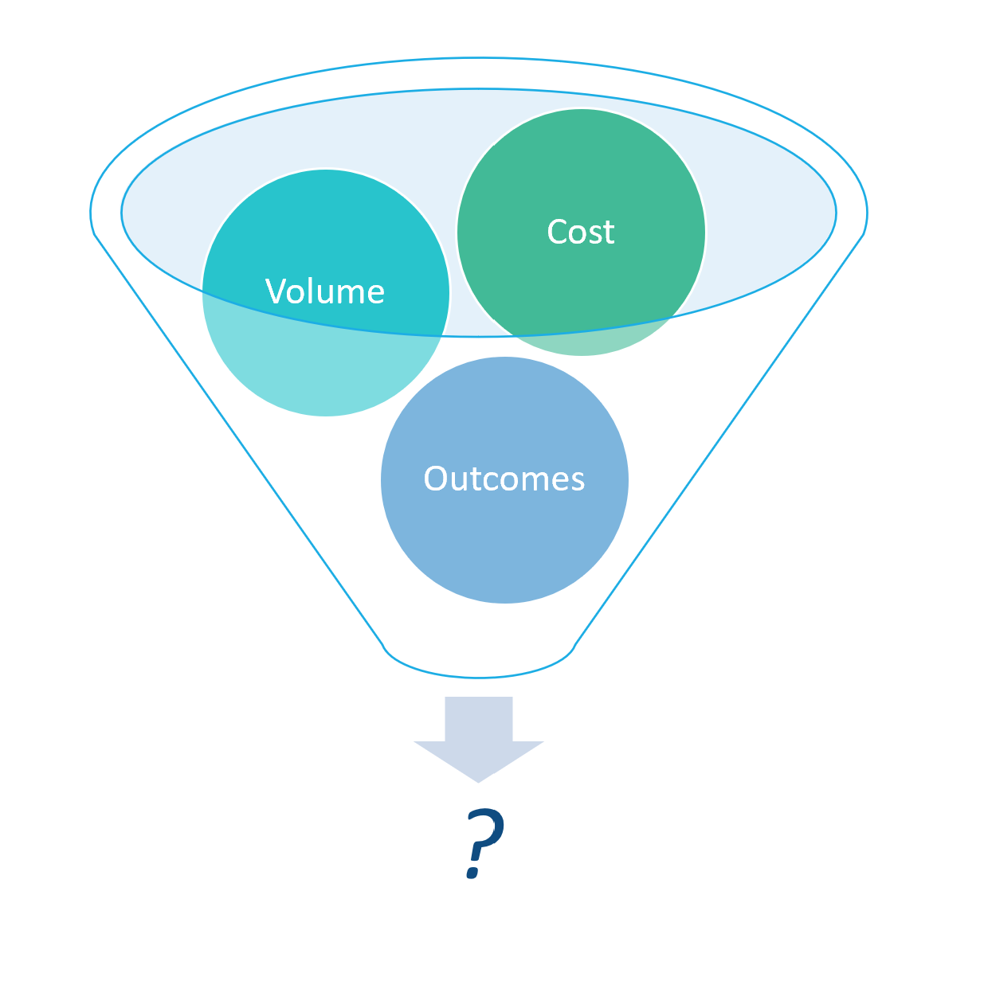
Payment reform: end of the national tariff?

Slide 29
Payment Reform: evolution or revolution?
Health and Care Bill replaces national tariff with NHS Payment Scheme
NHSE must consult on and publish pricing rules each year – which may or may not include national prices
Moving away from published prices towards guidance and tools that facilitate each ICS designing its own payment rules within national policy framework
2022/23 national tariff (re-)consultation proposes evolution of the 2021/22 Aligned Payment & Incentive framework

Slide 30
Proposed national support for locally designed payments
NHS Payment Scheme – expected to include National Tariff (non-mandatory) and local pricing rules (mandatory)
National Cost Collection – analysis of providers’ historic costs v peers – to enable benchmarking, planning, intelligent payments, etc
Costed GIRFT pathways – costing of ‘exemplar’ pathways to enable comparison and discussion, starting with cataracts
Population group analysis – analysing population resource usage by segment
Programme budgeting – whole system costs by healthcare condition
The Model Health System website brings these tools together (https://model.nhs.uk/)

Slide 31
National Tariff 2022/23 consultation: ‘Aligned Payment & Incentive approach’
Majority of payment to be fixed block – basis and % to be locally agreed
Remainder to be variable payment to reflect
elective volume +/- @75% of price
best practice tariff achievement (top up £)
CQUIN achievement (1.25% included in block/tariff, can be clawed back)
Applies to contracts where either members of the same ICS or over £30m pa
Also note reform of Non-Contract Activity to block-based payment
Mandated in theory from 1/4/22 (NB Tariff not yet published… in practice could be 1/7/22 when ICSs due to commence?)

Slide 32
Possible future contract/payment flows: provider collaboratives
Provider Collaborative
Lead provider
Sub-con provider
NHS England
ICB
Provider Collaborative
Provider 1
delegation
£ funding
contract
Provider 2

Slide 33
Possible future payment flows: place-based partnerships
NHS England
ICB
Place-Based Joint Committee
Place
Providers
Local Authority
delegation
£ funding
contract
Providers

Slide 34
Changes to Specialised Commissioning

Slide 35
Changes to specialised commissioning: 4 principles set out by NHS England
Specialised services will continue to be commissioned on the basis of national evidence-based service specs
Commissioning, decision-making and accountability will take place at the ‘appropriate’ level – ICS, supra-ICS or nationally
Clinical networks and provider collaboratives will drive service improvement and transformation
Funding to be rebased from ‘host provider’ back to population-based
https://www.england.nhs.uk/wp-content/uploads/2021/01/integrating-care-next-steps-to-building-strong-and-effective-integrated-care-systems.pdf

Slide 36
Changes to specialised commissioning: envisaged timetable
By April 2022 (July 22?):
“ICBs will establish mechanisms to strengthen joint working between NHS England and NHS Improvement and ICSs, including through joint committees, across all areas of direct commissioning”
By April 2023:
“ICBs will have taken on delegated commissioning responsibility for a proportion of specialised services (subject to system and service readiness) with national standards and access policies remaining at a national level”
https://www.england.nhs.uk/commissioning/wp-content/uploads/sites/12/2021/07/PAR817-NHS-England-and-NHS-Improvements-direct-commissioning-functions.pdf

Slide 37
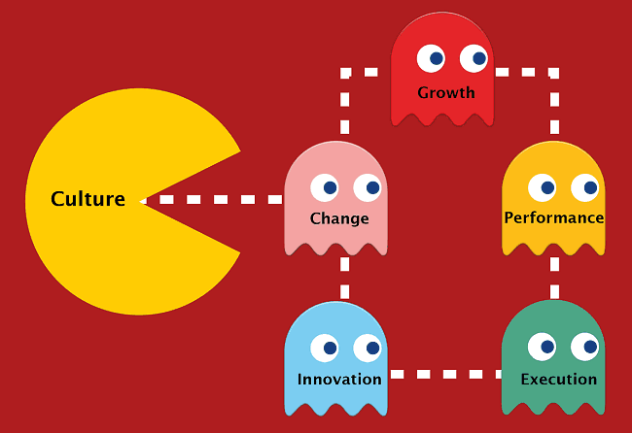
Finally… summing up the vision of the brave new world

Slide 38
What might this look like for a CCG/ICB?
Provider collaboratives will drive much of the new agenda operationally, taking on delegated responsibility for day-to-day commissioning as well as providing services
ICBs & ICPs will have overall strategic oversight of the ICS’s desired patient outcomes and manage the funding of the integrated care strategy
Annual contracts replaced with longer term funding agreements that provide more stability and opportunity to plan than monthly activity x tariff
This will include most specialised commissioning, delegated from NHSE to ICBs and provider collaboratives to manage, within national specs

Slide 39
What might this look like for a Trust?
Acute & MH Trusts should be part of one or more collaboratives by April 2022
Community & Primary care join Place-Based Partnerships
Over time, day-to-day commissioning/contracting will be delegated from the ICB to the provider collaboratives/partnerships
Specialised commissioning, where the main catchment area is the ICS, will also be delegated to provider collaboratives to deliver national specs
Contracts will evolve from activity x national tariff to locally-agreed block funding based on ‘efficient cost’, plus incentive payments for delivering agreed patient outcomes (which could include activity volume)

Slide 40
Integrated Care Systems: our thoughts in a nutshell
Opportunity to work differently and align the local system around common objectives
Can we develop a new model of networked leadership or will ICB become another layer of desktop management?
Put the horse before the cart… start with the patient and the desired outcomes
Redirect management time spent on contract disputes to improving patient services
Money will be the biggest constraint, particularly given public expectation around clearing COVID backlog… but it always is!
And the challenge of culture… leadership culture will eat the ICS strategy for breakfast!

Slide 41
Hope you found this useful…
Training slides on a variety of topics are available at:
http://baileyandmoore.com/resources/training-slides/

