Slide 1
Resilience
Dr Peter Carter OBE
June 2022

Slide 2
Overview of presentation
Explore what resilience is and how it is often misunderstood
Discuss models associated with developing resilience
Share some case studies
Context pre and Post COVID
The business case for wellbeing

Slide 3
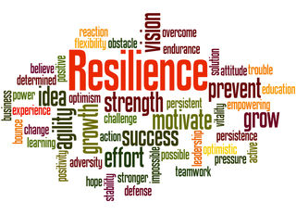
Resilience- A word frequently used and often misunderstood
Definition: The capacity to recover quickly from difficulties, toughness.
The ability of a subject or object to spring back into shape.

Slide 4
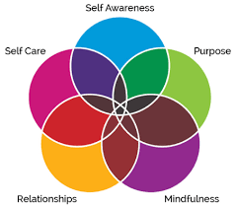
Ahlschlager, 5 Pillars of resilience
Self awareness
Mindfulness
Self care
Positive relationships
Purpose.

Slide 5
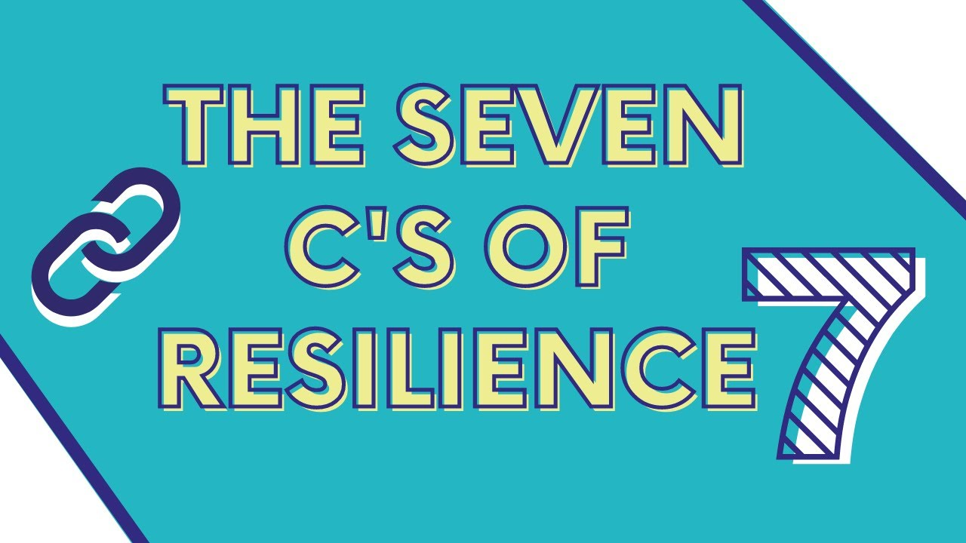
Ginsberg, 7 C’s of resilience
Competence
Confidence
Connection
Character
Contribution
Coping
Control

Slide 6
British Psychological society
“The psychological needs of healthcare staff as a result of Coronavirus”.
Three phases of psychological responses.
(1) Preparation phase
Planning what might happen.
2) Active phase
This phase has two components.
Heroics and surge solution: Increased camaraderie as staff cross boundaries and work together and a sense of rising to the challenge.
Disillusionment and exhaustion: The period of highest psychological risk. Staff are in the “Full go Mode” with high levels of adrenaline and on automatic pilot. They then may experience sudden exhaustion.
3) Recovery phase:
Staff have time to reflect. Most staff will be able to cope successfully using their own preferred style, individual resources and social support.
Others may feel different about their job and experience resentment towards individuals and organisations.
Certain staff may be at risk of chronic psychological difficulties, including but not limited to burnout and PTSD

Slide 7
Context – pre COVID
NHS Staff Survey results March 2019
Highest levels of stress recorded amongst NHS staff
Workforce crisis with more than 100,000 vacancies –with more than a third of GP’s intending to quit
Nurses’ and midwives’ stress levels leading to sickness levels at a new high
Nurses feeling desperate with chronic excessive workload and staff shortages
S, Bailey & Michael West 2020 Learning from staff experiences of Covid-19: let the light come streaming in. Kings Fund

Slide 8
Tidal wave of COVID 19
More than 193,713 people have died as a result of the pandemic in the United Kingdom so far. And with a disproportionate impact on those from ethnic minority groups and people in care homes. These have been the challenging times.

Slide 9
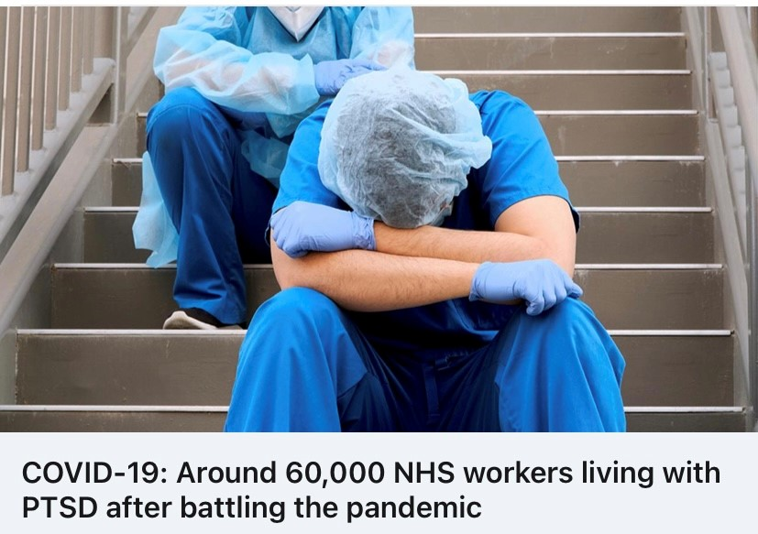
Burnout
“very simply, stress and burnout at work are when the demands on us exceed the resources that we have” Professor Michael West
“Staff who are burnt out are at an increased risk of error making and are more likely to suffer from low engagement (lack of vigour, dedication and absorption in work), cynicism, and compassion fatigue” Royal College of Midwives

Slide 10
Case study
Dawn Bilbough.
Filmed herself in a car park distressed as no food available in supermarkets. Impassioned plea to not panic buy.
Was Dawn lacking resilience? No, she was strong enough to show her frustration and to offer a remedy.
Winter of 2018
Massive snow fall. A Nurse walked 8 miles to her hospital carrying a rucksack with toiletries and change of clothes. Did not return home for 5 days. This was typical behaviour.

Slide 11
Pandemic
Copious examples of healthcare staff making huge sacrifices.
Staff moving out of their homes for months for fear of bringing the virus back to their families.
Children going to stay with Grandparents or other relatives

Slide 12
Pandemic
PPE issues.
Sending an army into battle without the armoury needed to fight the battle.
High rates of deaths.
Many nurses saw more deaths of patients in a few weeks that they might not have seen over several years.
Distressed relatives.
Staff under pressure from relatives at the time of death because of visiting restrictions. Having to call relatives to inform of the death of loved one.
Using iPads and smart phones to say good-bye.
All of the above resulted in nurses being taxed to the limit of their resilience.

Slide 13
The Business Case – Why Wellbeing matters
Clinical case-Clear link between staff burnout and patient safety. 16 out of 26 studies that measured wellbeing found a significant correlation between poor wellbeing and worse patient safety
Workforce case - improved wellbeing leads to a better functioning workforce and productivity, leading to improved staff experience, reduced absenteeism, presenteeism, turnover and improved retention
Financial case-£1.1 Billion annual cost of sickness and absence to the NHS
Hall, L (2016) Healthcare wellbeing, Burnout and Patient Safety: A systematic Review
Health Education England. (2019). NHS Staff and Learner's Mental Wellbeing Commission. Retrieved from https://www.hee.nhs.uk/sites/default/files/documents/NHS%20%28HEE%29%20-%20Mental%20Wellbeing%20Commission%20Report.pdf
Notes:
Our NHS workforce takes on massive responsibilities caring for our communities, often at the most traumatic part of their lives in high pressure environments. It comes at no surprise, the NHS workforce as a whole is at risk of poor wellbeing, including doctors and nurses. Evidence shows doctors and doctors in training are at-risk groups susceptible to burnout, suicide and mental ill health.
Evidence indicates doctors are at considerable risk of work-related stress and mental health problems such as depression and anxiety compared to the general population.
Rates of depression among training graduate doctors estimated at about 30%.
Risk of suicide especially among general practitioners, psychiatrists and trainees is high compared to the general population.
The suicide rate among UK doctors has been estimated to 2-5 times the rate of the general population.
Evidence shows nurses are at-risk groups susceptible to unhealthy lifestyle behaviours due to the impact of shift working.
Nurses are an at-risk group for unhealthy lifestyle behaviours. In an acute trust in the UK, more than half of the nurses surveyed did not meet public health recommendations for physical activity, indicating a need for intervention to establish healthy lifestyle behaviours early on in career. Promoting physical activity in student nurses increases wellbeing (self-esteem, life satisfaction) and decreases risk of anxiety and depression.
Impact of shift-working on nurse health and wellbeing. Nurses who work 12-hour shifts are two and half times more likely to experience symptoms of nurse burnout than those working shorter shifts.
Poor health and wellbeing affects patient care. Association between staff burnout and patient safety.
Use your trust’s workforce data to identify staff groups at risk of poor health and wellbeing. Examine different demographics (age, race, gender, etc) and work areas. Contextualise the potential negative consequences to both organisational outcomes and patient outcomes of not taking action to prioritise this staff group.
Our NHS workforce takes on massive responsibilities caring for our communities, often at the most traumatic part of their lives in high pressure environments. It comes at no surprise, the NHS workforce as a whole is at risk of poor wellbeing, including doctors and nurses. Evidence shows doctors and doctors in training are at-risk groups susceptible to burnout, suicide and mental ill health.
Evidence indicates doctors are at considerable risk of work-related stress and mental health problems such as depression and anxiety compared to the general population.
Rates of depression among training graduate doctors estimated at about 30%.
Risk of suicide especially among general practitioners, psychiatrists and trainees is high compared to the general population.
The suicide rate among UK doctors has been estimated to 2-5 times the rate of the general population.
Evidence shows nurses are at-risk groups susceptible to unhealthy lifestyle behaviours due to the impact of shift working.
Nurses are an at-risk group for unhealthy lifestyle behaviours. In an acute trust in the UK, more than half of the nurses surveyed did not meet public health recommendations for physical activity, indicating a need for intervention to establish healthy lifestyle behaviours early on in career. Promoting physical activity in student nurses increases wellbeing (self-esteem, life satisfaction) and decreases risk of anxiety and depression.
Impact of shift-working on nurse health and wellbeing. Nurses who work 12-hour shifts are two and half times more likely to experience symptoms of nurse burnout than those working shorter shifts.
Poor health and wellbeing affects patient care. Association between staff burnout and patient safety.
Use your trust’s workforce data to identify staff groups at risk of poor health and wellbeing. Examine different demographics (age, race, gender, etc) and work areas. Contextualise the potential negative consequences to both organisational outcomes and patient outcomes of not taking action to prioritise this staff group.
Our NHS workforce takes on massive responsibilities caring for our communities, often at the most traumatic part of their lives in high pressure environments. It comes at no surprise, the NHS workforce as a whole is at risk of poor wellbeing, including doctors and nurses. Evidence shows doctors and doctors in training are at-risk groups susceptible to burnout, suicide and mental ill health.
Evidence indicates doctors are at considerable risk of work-related stress and mental health problems such as depression and anxiety compared to the general population.
Rates of depression among training graduate doctors estimated at about 30%.
Risk of suicide especially among general practitioners, psychiatrists and trainees is high compared to the general population.
The suicide rate among UK doctors has been estimated to 2-5 times the rate of the general population.
Evidence shows nurses are at-risk groups susceptible to unhealthy lifestyle behaviours due to the impact of shift working.
Nurses are an at-risk group for unhealthy lifestyle behaviours. In an acute trust in the UK, more than half of the nurses surveyed did not meet public health recommendations for physical activity, indicating a need for intervention to establish healthy lifestyle behaviours early on in career. Promoting physical activity in student nurses increases wellbeing (self-esteem, life satisfaction) and decreases risk of anxiety and depression.
Impact of shift-working on nurse health and wellbeing. Nurses who work 12-hour shifts are two and half times more likely to experience symptoms of nurse burnout than those working shorter shifts.
Poor health and wellbeing affects patient care. Association between staff burnout and patient safety.
Use your trust’s workforce data to identify staff groups at risk of poor health and wellbeing. Examine different demographics (age, race, gender, etc) and work areas. Contextualise the potential negative consequences to both organisational outcomes and patient outcomes of not taking action to prioritise this staff group.

Slide 14
Risks associated with poor wellbeing
Doctors
Risk of suicide especially high among doctors.
Doctors are unlikely to disclose poor mental wellbeing.
Rates of depression among graduate doctors estimated at about 30%.
Nurses
Nurses are an at-risk group for unhealthy lifestyle behaviours.
The impact of shift-working on nurse’s health and wellbeing is evident
https://www.hee.nhs.uk/sites/default/files/documents/NHS%20%28HEE%29%20-%20Mental%20Wellbeing%20Commission%20Report.pdf

Slide 15
Compassionate Leadership
“A new approach to leadership is needed based on the core value of compassion. Compassionate leadership is not a soft option, it requires huge courage, resilience and belief, and sustaining cultures of high-quality compassionate care requires compassionate leadership at every level – local, regional and national – and in interactions between all parts of the system – from local teams to national leaders”.
S, Bailey & Michael West 2020 Learning from staff experiences of Covid-19: let the light come streaming in. Kings Fund

Slide 16
Teamwork
NHS research
reduced hospitalisation and costs
increased effectiveness and innovation
increased well-being of team members
multi-disciplinary teams deliver high quality patient care and implement more innovations
lower patient mortality
reduced error rates
reduced turnover and sickness absence
West 2010 , Aston University

Slide 17
4 factors of successful and resilient teams
Kirkman and Stoverink et al
They believe they can effectively complete the task.
Although each member of the team will have confidence in their own abilities, team members collectively believe they can be effective and complete the task.
They share a common mental model of teamwork.
All team members must be on the same page about their roles and responsibilities and the way they interact with each other during adversity.
They are able to improvise.
Team must be able to improvise and develop new ideas on ways of handling adversity. Improvisation is really about the deliberate process of handling adversity.
They trust one another and feel safe.
Team resilience is enhanced when team members share the belief that it is safe to take interpersonal risks such as offering unusual or creative ideas without fear of being criticised.
Teams will not function well without these pre-existing characteristics.
Teams cannot develop these characteristics in the white heat of an NHS working under extreme pressure

Slide 18
Where things go wrong.
The more hierarchical, the higher the chance of poor teamwork hence less resilience.
The lower down the pecking order the least able you are to make suggestions let alone challenge those in senior posts.
Some managers/leaders not skilled or lacking in awareness of the need to support staff.

Slide 19
Conclusions and learning?
During the pandemic.
Some positives have emerged.
The need to care for staff.
Greater focus on the working environment.
Enhanced staff facilities.
Time out.
Support structures.
Awareness of the need for teams to develop psychological safety.

Slide 20
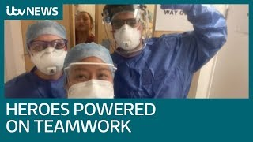
Thank you
carterp118@hotmail.com

