Slide 1
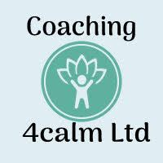
What is NLP?
A guide by Kirsty Coulston
Coaching4calm@gmail.com

Slide 3
Neuro Linguistic Programming
(NLP) is the study of what we do
in our heads when we create
success.
An art and science that shows us
how to positively change human
behaviour rapidly and easily
with permanent results.
A model of excellence

Slide 4
Why is learning NLP useful ?
New personal skills and tools:
Ability to communicate effectively
Influence and negotiate elegantly
The art of selling
Discovering what people really mean
Relationship building
Coaching skills
Therapeutic skills
How to create business success
Think differently and solve problems
Effective decision making
Leadership and management skill
Earn more

Slide 5
Neuro: The nervous system (including the mind) through which our experience is processed via five senses.
Visual - sight
Auditory - hearing
Kinesthetic - touch and feeling
Olfactory - smell
Gustatory - taste

Slide 6
Linguistic
Language and other non-verbal communication systems through which our neural representations are coded, ordered and given meaning, Include :
Pictures
Sounds
Feelings
Tastes
Smells
Programming
The ability to discover and utilise the programmes that we run (our communication to ourselves and others) in our neurological systems to achieve our specific and desired outcomes.

Slide 7
In other words, NLP is how to use the language of the mind to consistently achieve our specific and desired outcomes.

Slide 8
Let’s become the best version of ourselves.
Perception is projection
126 bps (Brain)
7 +/- 2 Chunks
12,000,000 bps
We delete,distort and generalise

Slide 9
NLP techniques can change peoples states, behaviour and the results they are getting in their life.
The problem is never the external event. It’s the internal representation of that event.
Cause and effect is a framework of thinking that is all about responsibility. It is about taking responsibility so you can hold on to your power rather than give it away, which will leave you feeling more empowered
=
>
Cause
Effect
Empowerment

Slide 10
Most people live in the effect side of the equation, which is what happens externally. NLP enables us to live on the Cause side where we can create our own experience moment by moment.
Which side are you on?

Slide 11
NLP
Five principles for success
Know your outcome
1
Take action
2
Have sensory acuity
3
Have behavioural flexibility
4
Operate from a physiology and psychology of excellence
5

Slide 12
The Presuppositions of NLP
Convenient Assumptions
1. Respect for the other person’s model of the world.
2. Behaviour and change are to be evaluated in terms of context and Ecology.
3. Resistance in a client is a sign of a lack of rapport. There are no resistant clients, only inflexible communicators. Effective communicators accept and utilise all communication presented to them.
4. People are not their behaviours (accept the person change the behaviour).
5. Everyone is doing the best they can with the resources they have available. Behaviour is geared for adaptation and present behaviour is the best choice available (every behaviour is motivated by a positive intent).

Slide 13
6. Calibrate on behaviour: The most important information about a person is that person’s behaviour.
7. The map is not the territory (the words we use are not the event or the item they represent).
8. You are in charge of your mind, and therefore your results (and I am also in charge of my mind and therefore my results).
9. People have all the resources they need to succeed and to achieve their desired outcomes.
10. All procedures should increase wholeness.
11. Only feedback no failure.
12. The meaning of communication is the response you get.
13. The law of requisite variety.
14. All procedures should be designed to increase choice.

Slide 14
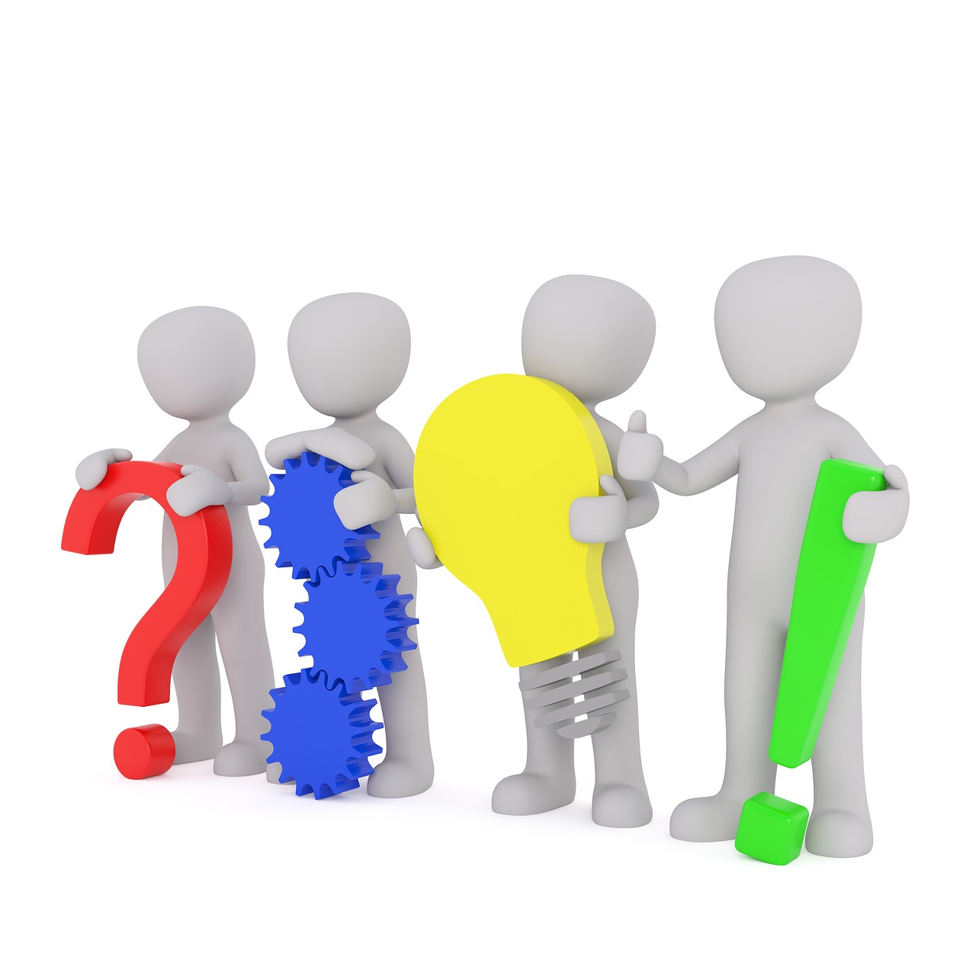
Language Section
What is rapport?
In NLP we define rapport as a state of responsiveness. Responsiveness means the person or people you are interacting with consciously and unconsciously respond to you and you therefore have the lead in the communication.
Theory
Communication is:
7% WORDS
38% TONALITY
55% PHYSIOLOGY
When people are like each other, they like each other. Rapport is a process of responsiveness, not necessarily ‘liking’.

Slide 15
Process of Rapport - Mirroring and Matching
WORDS (7%)
Predicates (the words that we use to describe our inner world to the outside world)
Key words
Common experience & association
Content chunks
PHYSIOLOGY (55%)
Posture
Gesture
Facial expression ; blinking
Breathing
TONALITY (38%)
Voice
Tone (pitch)
Tempo (speed)
Timbre (quality)
Volume (loudness)

Slide 16
A different frame of thought

Slide 17
Frames
A strategy to redirect a person's argumentative energy rather than overcome it.
The agreement frame
I appreciate and …
I respect and …
I agree and …

Slide 18
Frames
The purpose frame
‘for what purpose’
Avoid using ‘why’ it can be perceived as confrontational.

Slide 19
Position 2
Standing in the other person’s shoes.
Position 1
Seeing the world through our own eyes.
Perceptual positions
Position 3
Neutral observer

Slide 20
